Slide 1

Neural Substrates of Attention and Awareness
Dan Birman
Gardner Lab
Lightning Talks – 2015-04-23

Slide 2


Slide 5
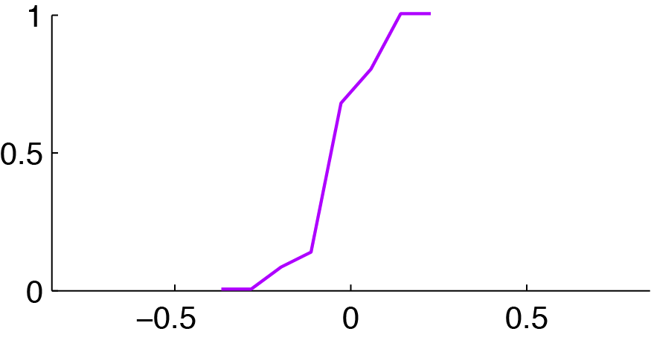
Attention Controls Perception
100% Correct
Attending Motion
0% Correct

Slide 6
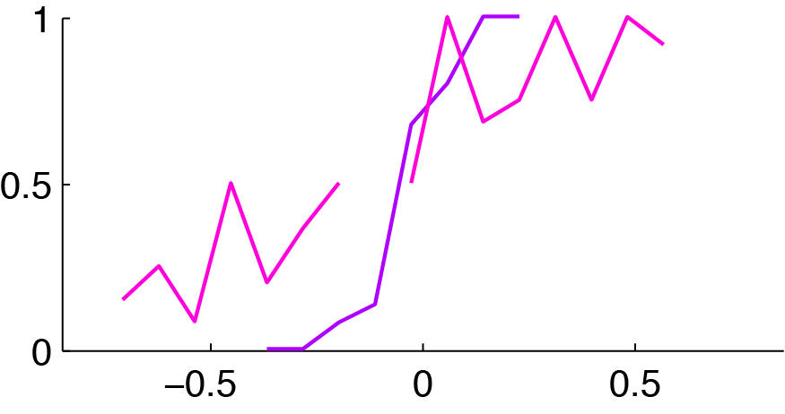
Attention Controls Perception
Attending Motion
Attending Contrast:
Asked about Motion

Slide 7
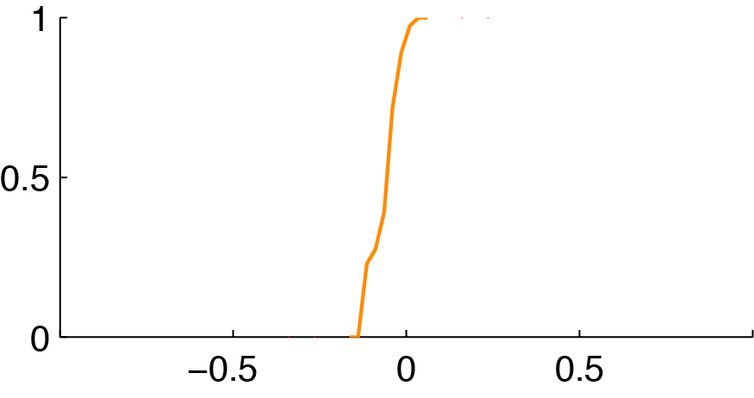
Attention Controls Perception
100% Correct
Attending Contrast
0% Correct

Slide 8
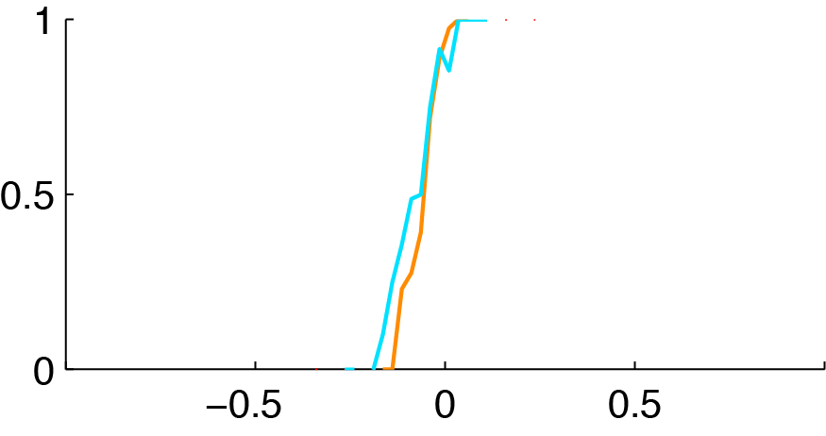
Attention Controls Perception
Attending Contrast
Attending Motion:
Asked About Contrast

Slide 9
Attention Controls Perception
Attending Motion
Attending Contrast:
Asked about Motion
Attending Contrast
Attending Motion:
Asked About Contrast

Slide 10
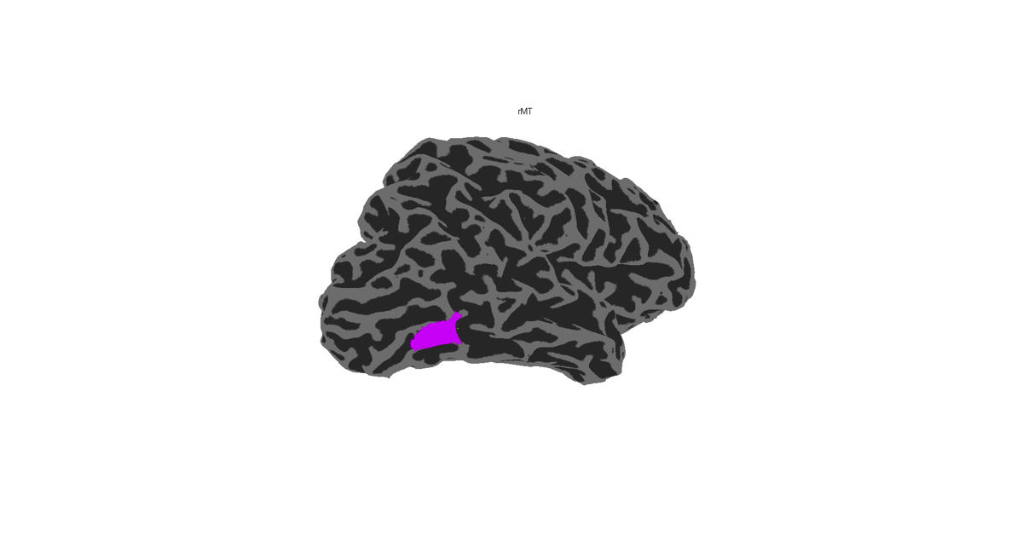
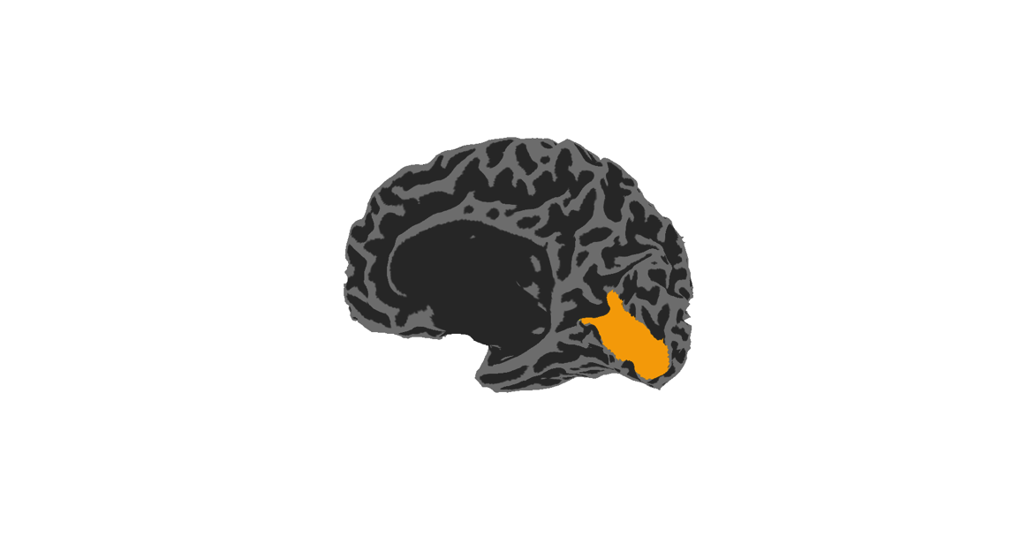
Attention & Visual Hierarchy
hMT
Motion Readout Area
V1
Contrast Readout Area

Slide 11
Attention & Visual Hierarchy
hMT
Response
Stimulus Intensity
V1

Slide 12
Response
Stimulus Intensity

Slide 13
Response
Stimulus Intensity

Slide 14
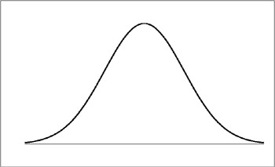
Response
Stimulus Intensity

Slide 15
Attention & Visual Hierarchy
Attending Motion
Attending Contrast:
Asked about Motion
hMT
Attending Contrast
Attending Motion:
Asked About Contrast
V1

Slide 16
Attention & Visual Hierarchy
Attending Motion
Attending Contrast:
Asked about Motion
hMT
Attending Contrast
Attending Motion:
Asked About Contrast
V1

Slide 17
Response Corruption Model
Attention
To Contrast

Slide 18
Response Corruption Model
Attention
To Motion
Attention
To Contrast

Slide 19
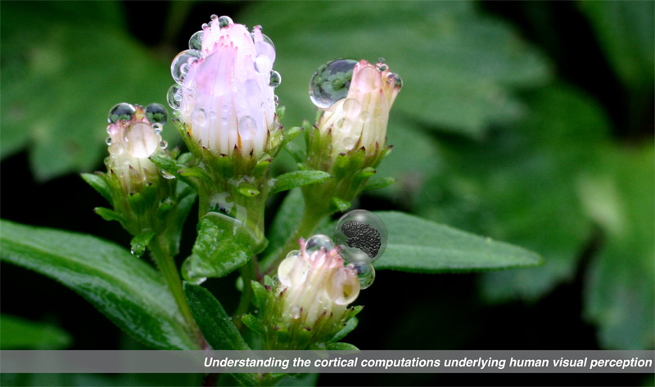

Gardner Lab @ Stanford University
Justin Gardner

